Slide 1
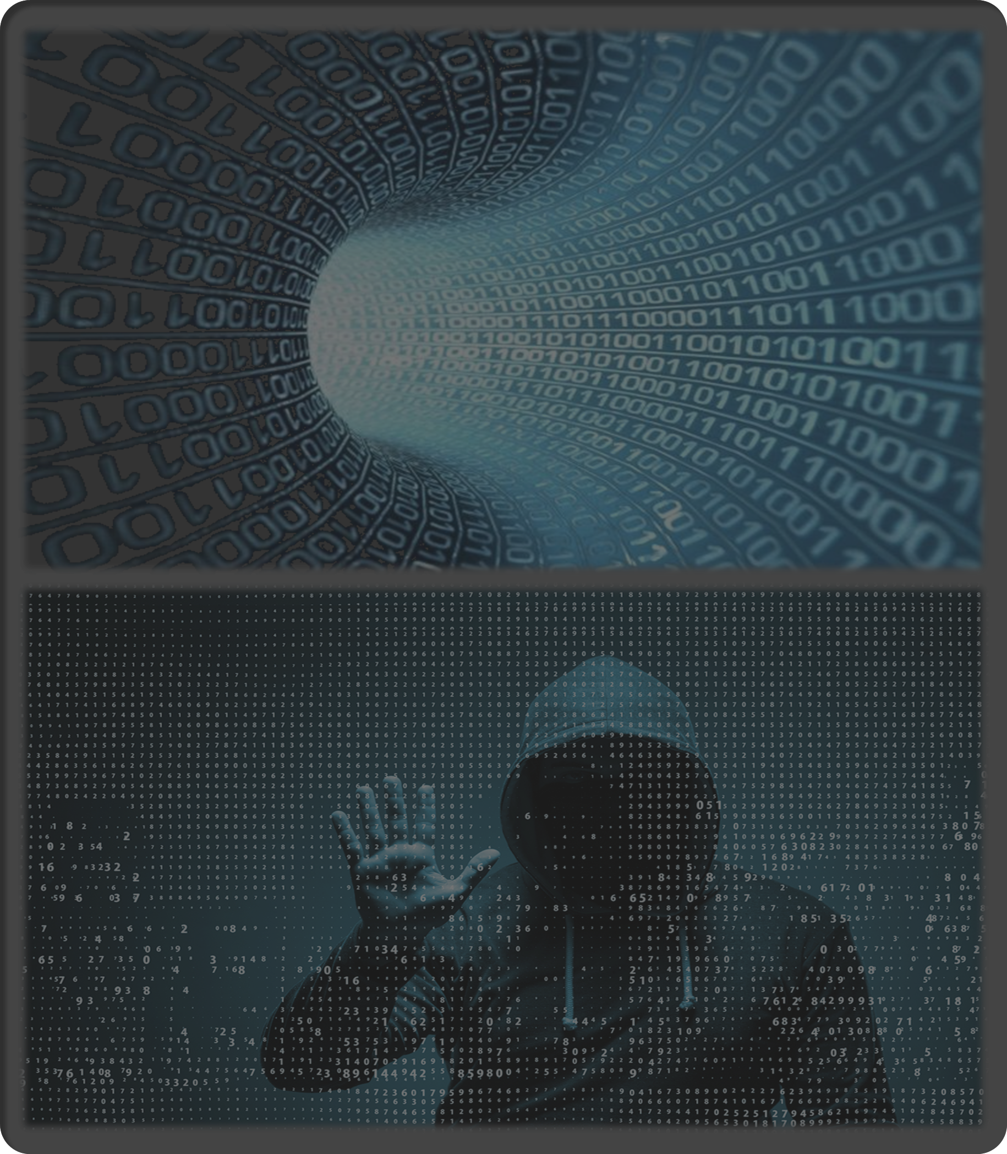
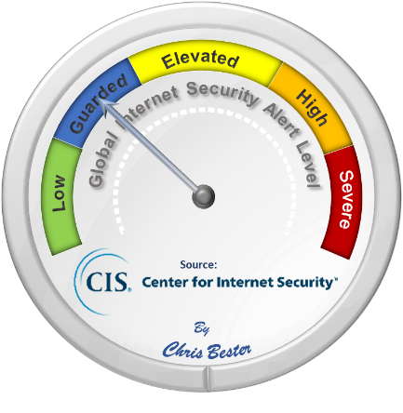
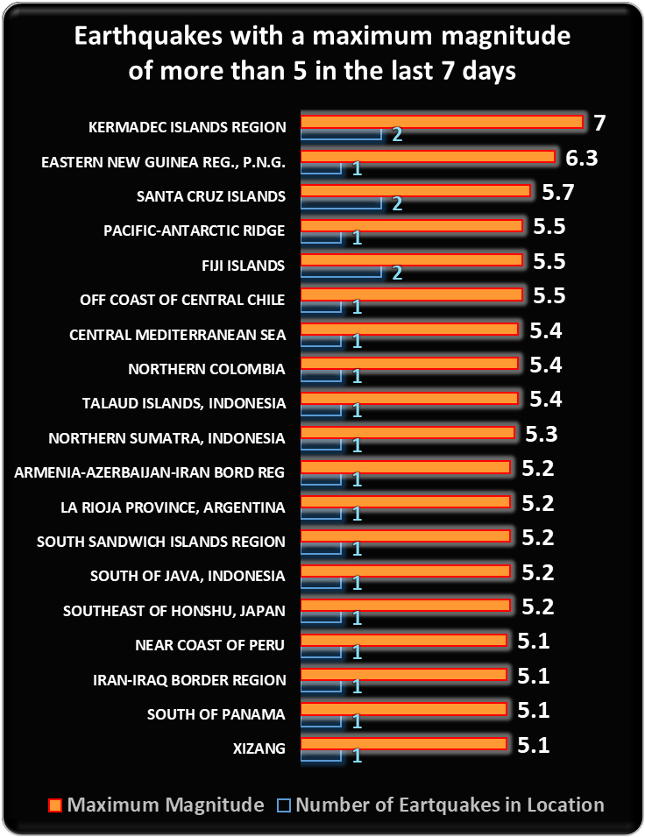
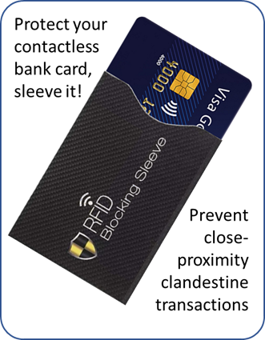
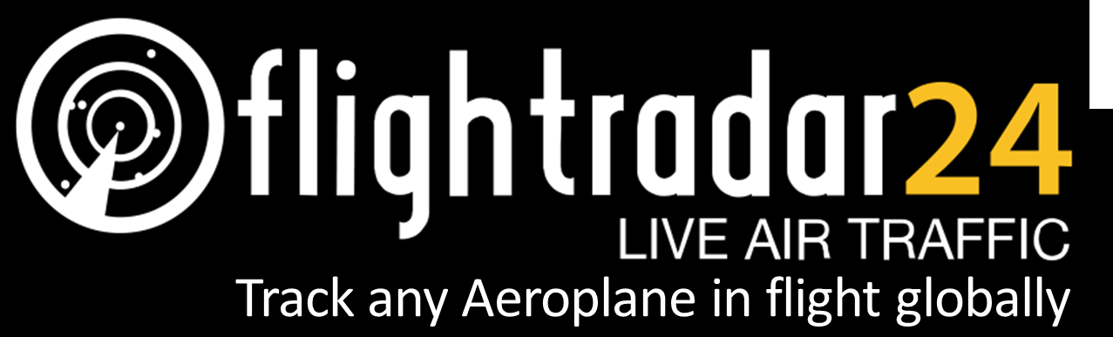



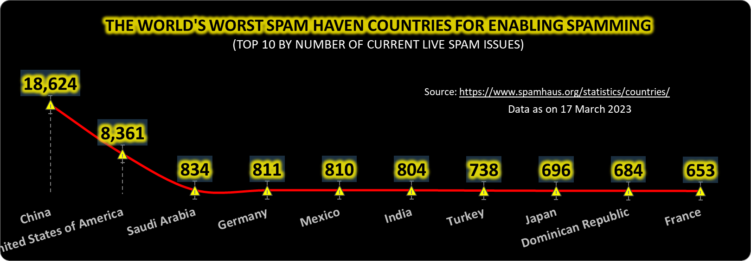
On March 8, the Cyber Threat Alert Level was evaluated and is remaining at Blue (Guarded) due to vulnerabilities in Google products. (No change recorded this week) CIS Security Advisories
Threat Level’s explained
GREEN or LOW indicates a low risk.
BLUE or GUARDED indicates a general risk of increased hacking, virus, or other malicious activity.
YELLOW or ELEVATED indicates a significant risk due to increased hacking, virus, or other malicious activity that compromises systems or diminishes service.
ORANGE or HIGH indicates a high risk of increased hacking, virus, or other malicious cyber activity that targets or compromises core infrastructure, causes multiple service outages, causes multiple system compromises, or compromises critical infrastructure.
RED or SEVERE indicates a severe risk of hacking, virus, or other malicious activity resulting in widespread outages and/or significantly destructive compromises to systems with no known remedy or debilitates one or more critical infrastructure sectors.
WEEKLY IT SECURITY BULLETIN
17 March 2023
In The News This Week
TikTok ban: UK minister asks National Cyber Security Centre to look into safety of app
Security minister Tom Tugendhat does not rule out following other governments in banning the Chinese-owned video sharing app from work phones but says he will comment further after seeing the centre's report. - UK security minister Tom Tugendhat has asked the National Cyber Security Centre (NCSC) to look into TikTok after governments around the world have begun banning it from their work phones. The Chinese-owned video sharing app is increasingly under the European and US microscope over security and data privacy, with concerns it could be used to promote pro-Beijing views or gather user data. The EU Commission and more than half of US states and Congress have already introduced a ban over concerns around potential cyberattacks.… But TikTok has hit back, calling government bans "misguided and based on fundamental misconceptions“… Read the full article by Jennifer Scott here: Sky News
Zoll Medical Data Breach Impacts 1 Million Individuals
Medical technology developer Zoll Medical is notifying roughly one million individuals that their personal information might have been compromised in a recent data breach. - Zoll develops and markets medical equipment and software for advanced emergency care, including cardiac monitoring, oxygen therapy, ventilation, data management, and more. The data breach, the company says, was identified at the end of January, when it discovered unusual activity on its internal network. “We determined that your information may have been affected on or about February 2, 2023. Our investigation into the incident is ongoing,” Zoll wrote in a notification letter, a copy of which was submitted to the Maine Attorney General’s office. According to Zoll, the compromised information included names, addresses, birth dates, and Social Security numbers.
Read more by Ionut Arghire here: Security Week
Hackers steal around $200 million from crypto lender Euler Finance
On Monday, the blockchain monitoring firm PeckShield sent an ominous tweet directed at the crypto lending platform Euler Finance, simply saying: “Hi […] you may want to take a look.” What the firm was suggesting Euler take a look at was a series of transactions that indicated there was an ongoing hack against Euler. According to PeckShield, hackers exploited Euler “in a flurry of transactions” which led to the theft of around $197 million in crypto. Crypto security firm BlockSec also reported the attack. While this sounds like a lot of money — and it is — it’s only the 26th largest crypto theft ever, according to a website that keeps track of crypto hacks and scams. “We are aware, and our team is currently working with security professionals and law enforcement,” Euler wrote in response to the tweet. “We will release further information as soon as we have it.”. Read the full story by Lorenzo Franceschi-Bicchierai here: TechCrunch
Microsoft Warns of Large-Scale Use of Phishing Kits to Send Millions of Emails Daily An open-source adversary-in-the-middle (AiTM) phishing kit has found a number of takers in the cybercrime world for its ability to orchestrate attacks at scale. The Microsoft Threat Intelligence team is tracking the threat actor behind the development of the kit under its emerging moniker DEV-1101. An AiTM phishing attack typically involves a threat actor attempting to steal and intercept a target's password and session cookies by deploying a proxy server between the user and the website. Such attacks are more effective owing to their ability to circumvent multi-factor authentication (MFA) protections. DEV-1101, per the tech giant, is said to be the party behind several phishing kits that can be purchased or rented by other criminal actors, thereby reducing the effort and resources required to launch a phishing campaign.
Read the rest of the story by Ravie Lakshmanan here: The Hacker News
Cyberattackers Continue Assault Against Fortinet Devices
Patched earlier this month, a code-execution vulnerability is the latest FortiOS weakness to be exploited by attackers, who see the devices as well-placed targets for initial access operations. - n early March, a customer called in Fortinet's incident response team when multiple FortiGate security appliances stopped working, entering an error mode after the firmware failed an integrity self test. It was a cyberattack, which led to the discovery of the latest vulnerability in Fortinet devices, a medium severity but highly exploitable bug (CVE-2022-41328) that allows a privileged attacker to read and write files. The threat group, which Fortinet labeled as an "advanced actor," appeared to be targeting government agencies or government-related organizations, the company stated in a recent analysis of the attack. Read the by Robert Lemos here: Dark Reading
Latitude cyberattack leads to data theft at two service providers Australia - Latitude Financial Services (Latitude) has disclosed a data breach after suffering a cyberattack, causing the company to shut down internal and customer-facing systems. Latitude is one of Australia's largest personal loans provider and the country's largest non-bank consumer credit lender. A subsidiary of Deutsche Bank and KKE, the firm provides a broad spectrum of consumer finance services… Read the article by Bill Toulas here: Bleeping Computer
Tips on how to protect your credit card
If you haven’t had an attempt or are a victim of credit card fraud, you are one of the lucky few in the world. As we transition more and more into a cashless society, the pickpocket opportunist is not so much interested in the cash in your wallet anymore, but rather in the myriad of bank cards, you carry around. As most stores offer a tap-and-go or contactless payment service to reduce the risk of large amounts of cash on the premises, it became so easy to just tap for those smaller purchases. Most banking systems nowadays apply AI and machine learning techniques to recognize the stores you most frequently visit, and the average amount you spend. If the transaction then falls within the “safe” parameters, the transaction will be approved without asking you for a PIN code. Although very convenient for the cardholder, it unfortunately also opens up a huge opportunity for the criminal element out there. The same goes for online transactions that have been discussed in this forum many times.
At the end of the day, even though the banks are doing all they can to safeguard you, the responsibility still lies with you, the cardholder, to be vigilant and to take the necessary precautionary actions.
Pre-cautionary steps.
I’m sure most of us have seen or heard some of the precautionary steps and tips below, but it is always good to be reminded or even learn something you didn’t think of before.
Skimming - You've probably heard about skimming on the news, mostly occurring at gas stations or ATMs. Skimming is still the most common form of a credit card data breach, and they're one of the simplest breaches to set up and one of the easiest to miss. Skimmers are small devices, either standalone or attached to existing devices, that secretly and instantly copy any credit or debit card information. It's easy for anyone to fall prey to skimmers, but there are a few precautions you can take to protect yourself: (1) Always inspect card readers – If you see something odd or unfamiliar on the ATM’s card reader, be cautious. The same goes for self service payment facilities at gas stations. Gas stations and ATMs are such popular skimming targets because their card readers are unattended, and customers aren't paying as much attention as they would during transactions at other retailers. (2) Use credit cards over debit cards - You should always favor credit cards over debit cards whenever there's a possibility of skimming. Debit cards link more directly to bank or credit union accounts, and with credit cards, there's an extra layer of protection between thieves and your money. Under federal law in the US, you're only responsible for $50 in unauthorized charges taken out of a stolen credit card. (3) Monitor your accounts - Always keep an eye on your accounts. If you see any unauthorized or unfamiliar activity, be sure to contact your card issuer immediately and freeze your account.
Physical theft - It's always possible to have your identity stolen via the physical theft of your wallet, purse, or credit card. And if you use your phone for banking -- as more and more people do - then the theft of your phone or even your smart watch may also put your personal information at risk.
Luckily, the preventative measures for physical theft are still tried and true: (1) Keep personal items safe and out of sight. Out of sight, out of mind, don’t raise the attention of the opportunistic thief. (2) Destroy unnecessary material that has personal information. If someone get hold of an old, expired bank card, your personal information is still on there. (3) Keep track of incoming material, such as physical mail. If you expect a bank statement in the mail and didn’t get it, it could have been nicked from your mailbox. Consider using electronic mail for statements and other items that contains personal information only .
Tap-and-go or contactless payment – Everybody loves the convenience of contactless payment, but this comes with its own risks. A contactless credit card uses RFID (radio-frequency identification) technology to enable you to hover or tap a card over a card terminal as a means of conducting a transaction. The card emits short-range electromagnetic waves containing your credit card information to be captured by the point-of-sale system. The system, however, can be compromised by someone standing close to you with a hidden RFID reader or card machine, or a dishonest teller presenting you with an unauthorized card machine not linked to the store’s Point of Sale (POS) system.
Fortunately, there are some preventative measures you can take: (1) Be cautious of someone standing very close to you in a queue or at the pay point, or if you feel like someone is invading your personal space for no reason. The person might have a hidden RFID reader and try to get close enough to you to invoke an illegal contactless transaction. A simple way to avoid this is to store your credit card in an RFID-blocking sleeve. These are thin inexpensive paper or silicon sleeves that block any RFID signal reading information from the card. You physically have to take the card out of the sleeve to tap for the transaction. These sleeves can be purchased from many online or electronic trinket stores, or your bank may even offer these for free. (2) Where practicable, insist on a transaction slip from the credit card machine and a till slip and take a few seconds just to scan if the till slip states “cash” or “card". Although most Point of Sale (POS) systems are robust enough to prevent these kinds of things, there are ways to bypass the system. (3) If you didn’t activate the facility yes, ask the bank to send a text message to your phone the moment a transaction took place.
Encrypting physical credit cards - At a minimum, all consumers should have chip-based cards. If you have any magnetic-stripe cards remaining in your wallet, contact your issuer and see if they have updated cards available. If it's possible to use a chip instead of swiping your card while shopping, always do so. The same goes for contactless credit cards or mobile wallets. Both options offer more encryption and thus higher amounts of security than magnetic-stripe systems
Telephone scams - Telephone scams have a reputation for targeting Baby Boomers, but believe it or not, Millennials are actually more likely to give away personal information over the phone. Here are a few things to keep in mind: (1) Never give out information to a cold caller, specifically, any credit card details. Don’t laugh, some people do! (2) If you don’t recognize the number, don't respond immediately, let it go to voicemail. Many modern phone scams are made via robocall and won't leave a message if they go to voicemail. If they do leave a message, don’t call the number back, rather call the organization. (3) Cold-calling scams have grown more sophisticated over the years. With new "Can you hear me?" scams, you'll be greeted with a voice on the other line asking if you're able to hear them. But the call is being recorded, and if you respond "yes", your voice may be captured and used to authorize fraudulent transactions. – Just don’t respond and put the phone down, if it is a legitimate call, they will find another way to contact you.
There are many more tips and advice I can share on how to keep your card and card transactions safe, most important though, be vigilant, and be wary of anything out of the ordinary if it comes to card transactions. Resources: ZDNet
For Reporting Cyber Crime in the USA go to (IC3) , in SA go to Cybercrime, in the UK go to ActionFraud
Other Interesting News and Cyber Security bits:
The best Bluetooth trackers you can buy
GPT-4 unveiled: ChatGPT's next big upgrade is here
Defeating the Deepfake Danger
ChatGPT vehicle AI turns your car into a professional gaslighter
SANS Daily Network Security Podcast (Storm cast)
Author: Chris Bester (CISA,CISM)
chris.bester@yahoo.com

